Slide 1
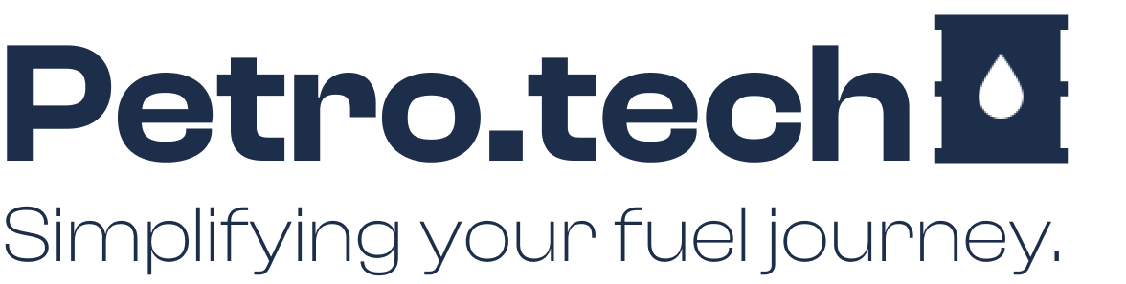
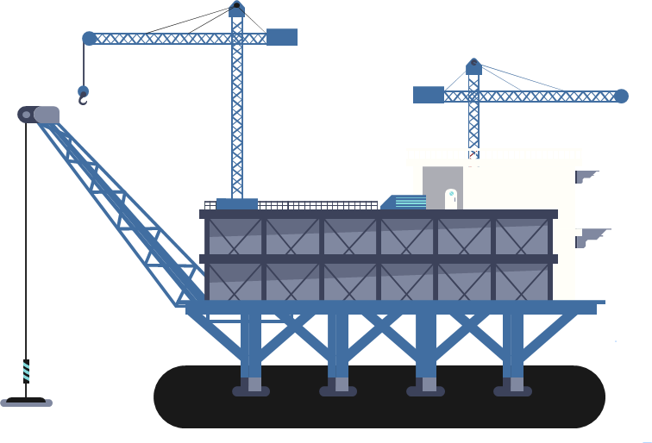
DR. EMAD RAOUF
Made BY.
Zyad Elsaka
Mohamed Mansour
Mohamed Elmadawy
Andrew Samir

Slide 2
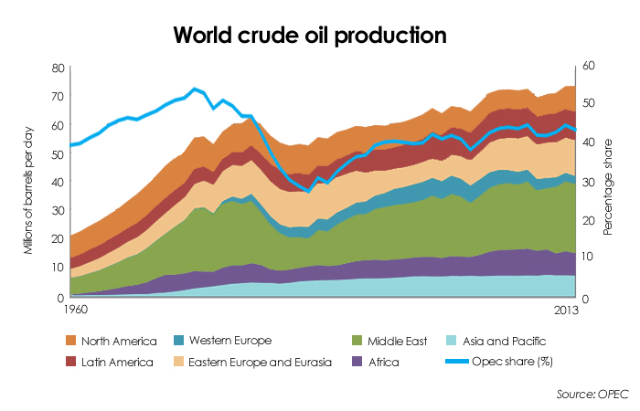
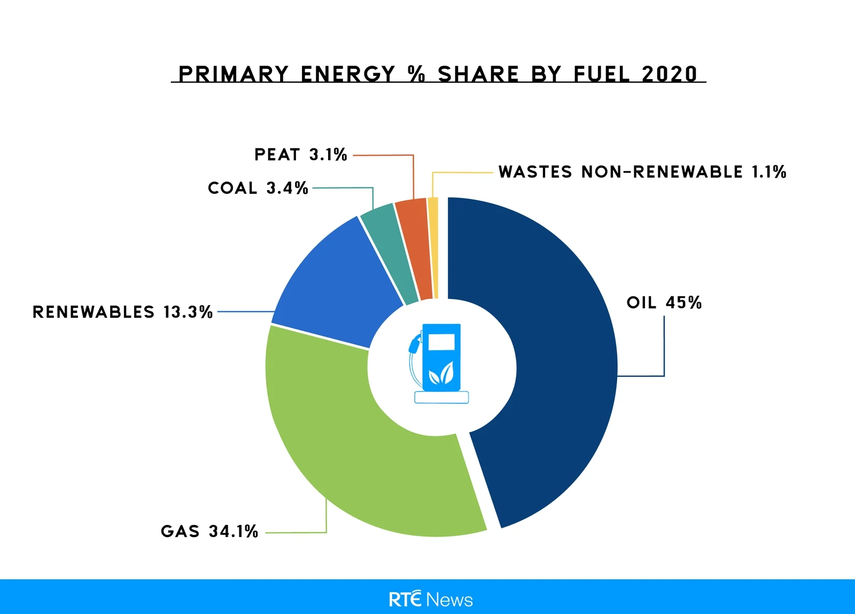
How do we generate energy?
About 50% of energy worldwide is generated using OIL.
Even though there is a global direction to clean energy, but up till now the oil & gas industry is dominant.
Total world oil production in 2021 averaged 77,043,680 barrels per day!!!
This might need some extensive research…

Slide 3
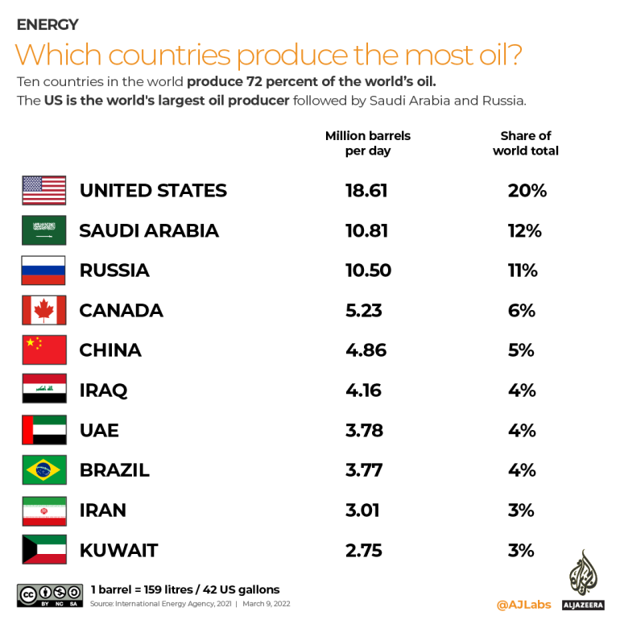
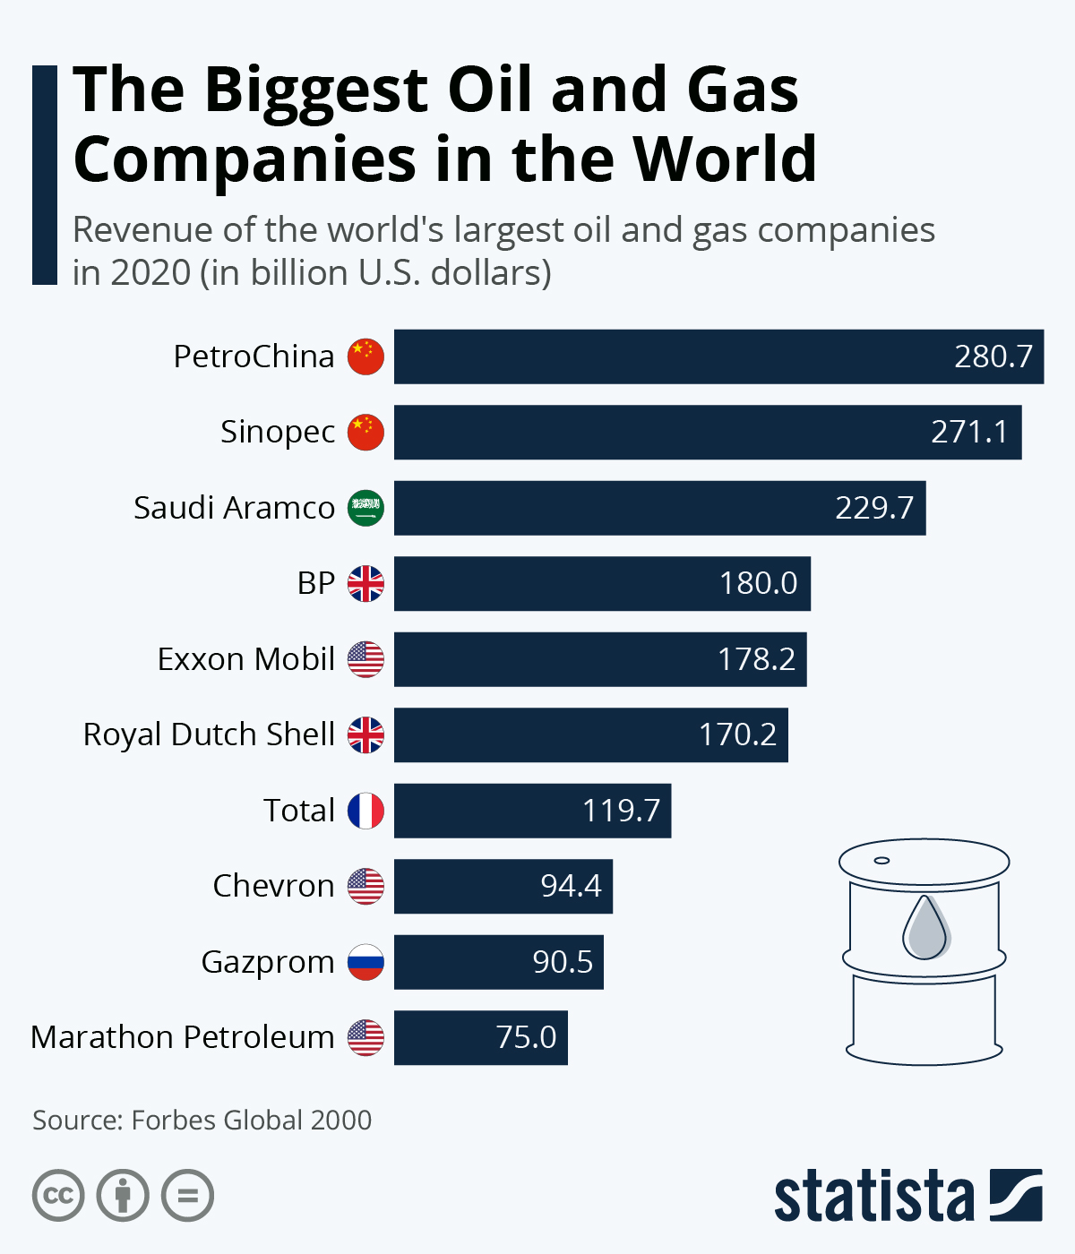
How large is the oil industry?
Many countries consider the oil industry as the main economic asset!
No wonder since the industry has proven stability and profitability since day one.
As a result, any country with suitable resources is eager to invest join the oil club.

Slide 4
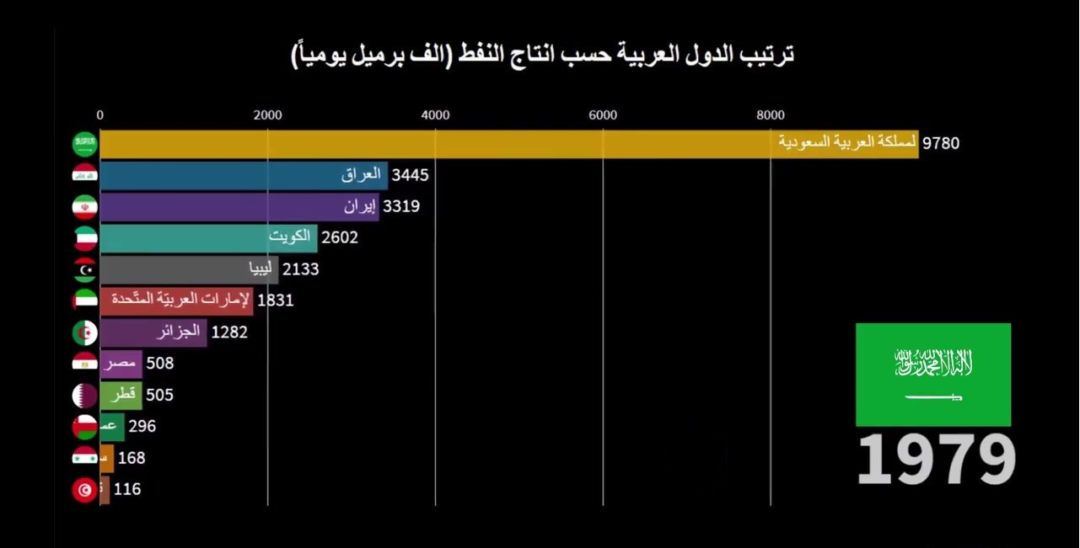
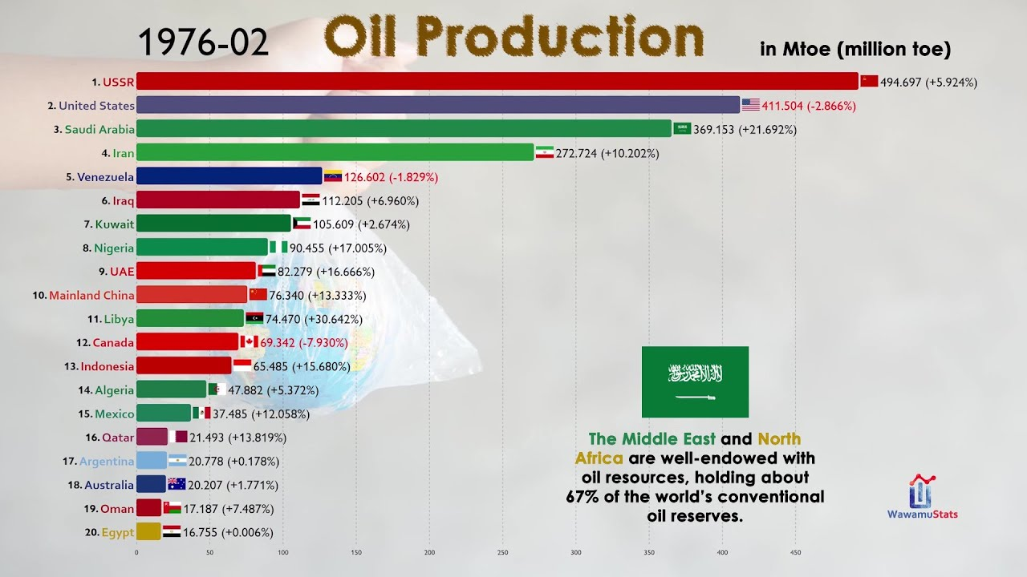
Hey, did you notice middle east countries in the previous slide?
The middle east (north Africa) is well endowed with oil resources, holding about 67% percent of the world’s conventional oil reserves.
Within middle east, Saudi arabia holds 27% of
Egypt? Egypt produce about 500 thousand oil barrel per day! , benefiting about 20 Mtoe dollar in revenue.

Slide 5
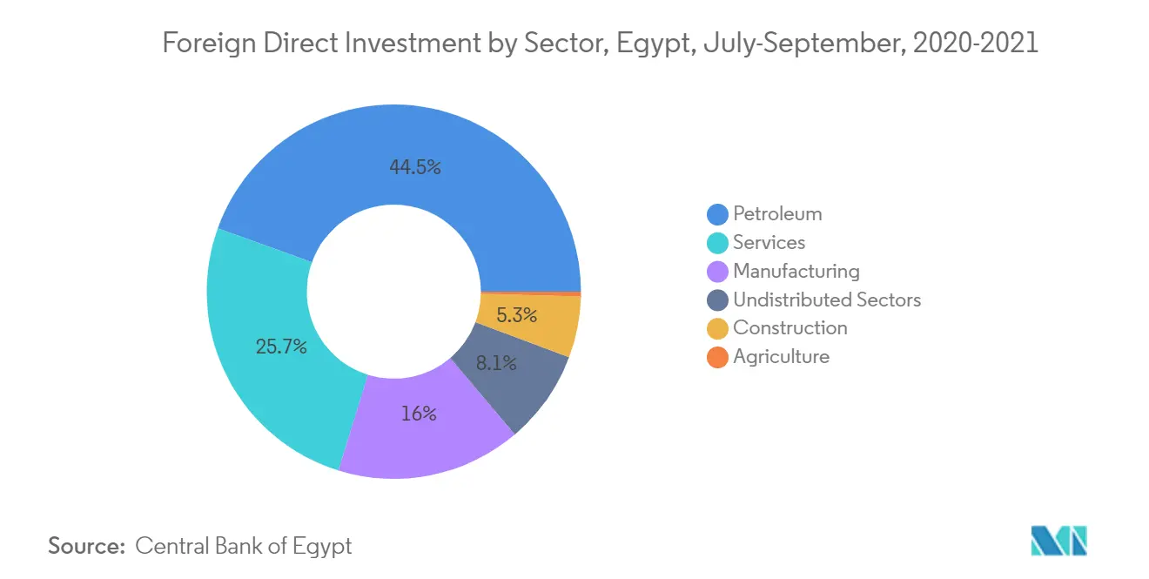
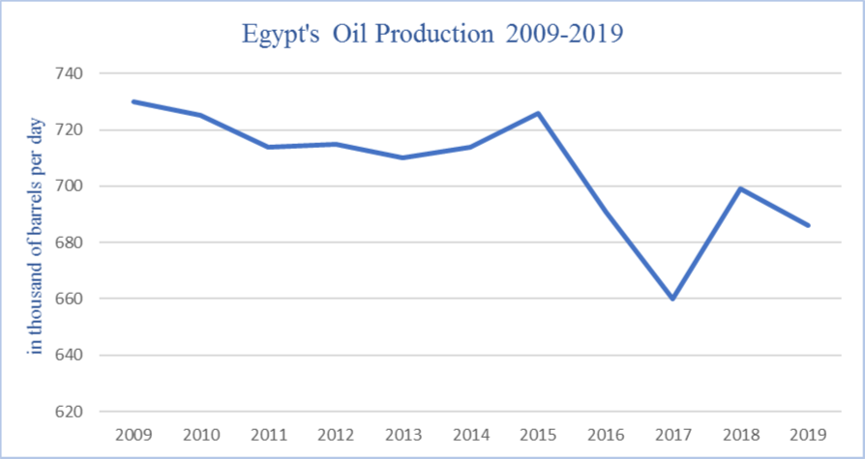
How close is Egypt to the industry?
Starting from the late 90s, Egypt started to foresee the potential of investing in the industry.
Going through the start of 2010 , the industry has proven high ROI.
Which encouraged Egyptian government and abroad companies and investors to expand even more.
Unlike many other products, oils involve a long and expensive process to extract and refine, aside having the proper resources and infrastructure.

Slide 6
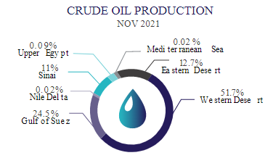
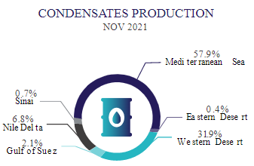
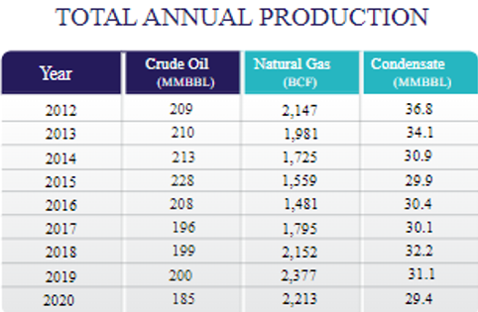
Some defining numbers

Slide 7
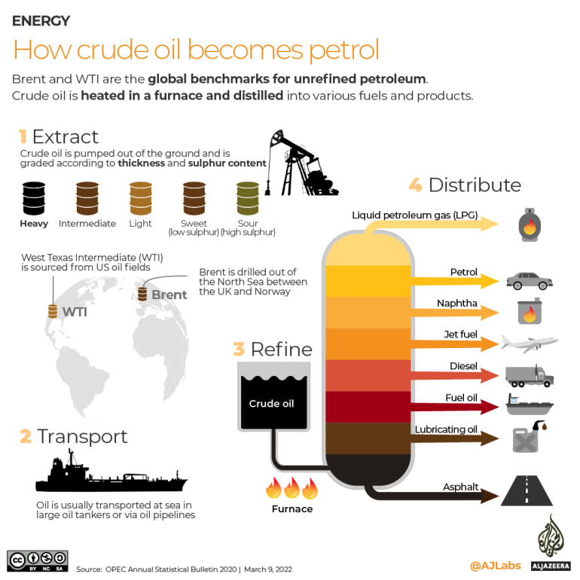
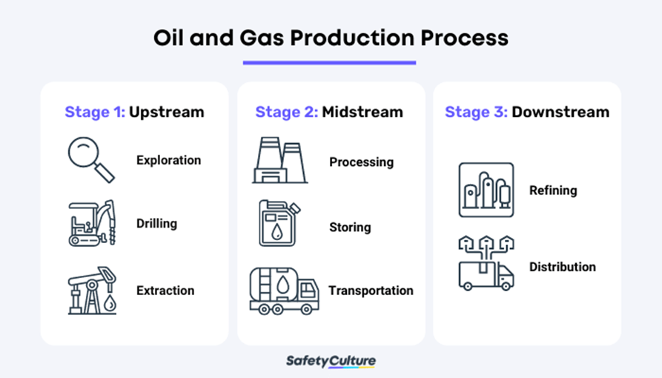
What is the process?
The process is divided into three
sub-categories:
Upstream
Midstream
Downstream

Slide 8
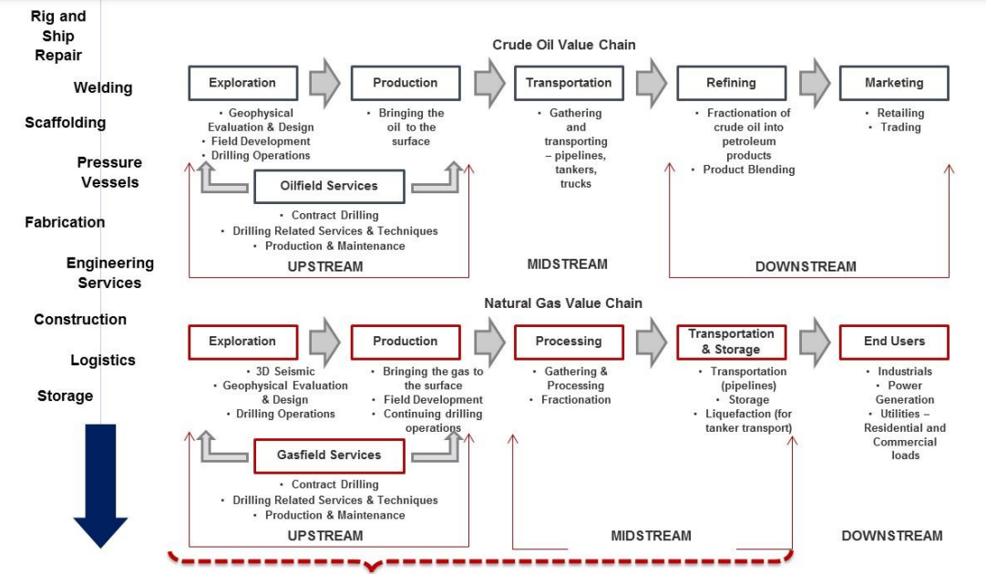

Slide 9
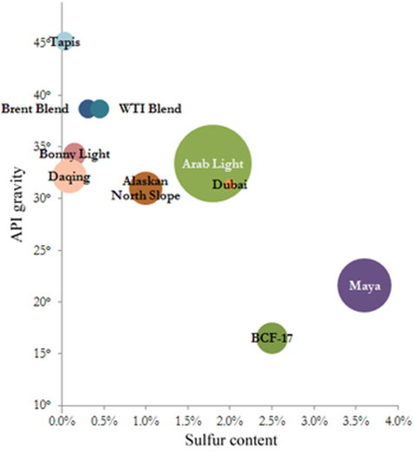
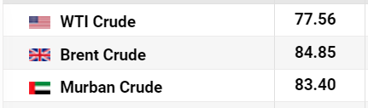
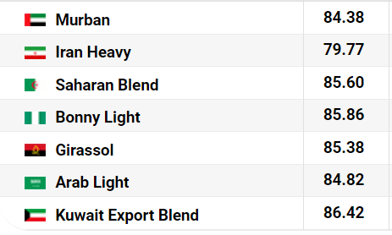

Raw materials for the process
The geographic location is important because it affects transportation costs to the refinery. Light crude oil is more desirable than heavy oil since it produces a higher yield of gasoline, while sweet oil commands a higher price than sour oil because it has fewer environmental problems and requires less refining to meet sulfur standards imposed on fuels in consuming countries. Each crude oil has unique molecular characteristics which are revealed using Crude oil assay analysis in petroleum laboratories.
Barrels from an area in which the crude oil's molecular characteristics have been determined and the oil has been classified are used as pricing references throughout the world.

Slide 10
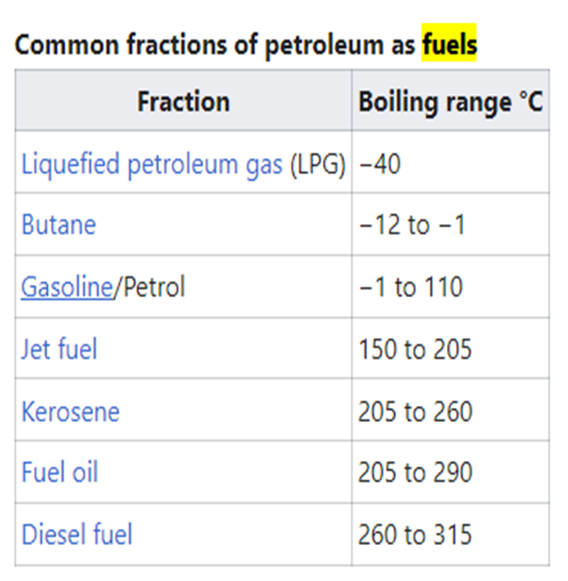
What are the products of the process?
The most common distillation fractions of petroleum are fuels.
Gaseous fuel such as liquified petroleum gas and propane, stored and shipped in liquid form under pressure.
Lubricants (light machine oils, motor oils, and greases)
Petrochemicals are organic compounds that are the ingredients for the chemical industry, including ethylene and benzene-toluene-xylenes ("BTX") which are often sent to petrochemical plants for further processing in a variety of ways.
Others include Naphtha, bitumen petroleum wax/jelly.

Slide 11
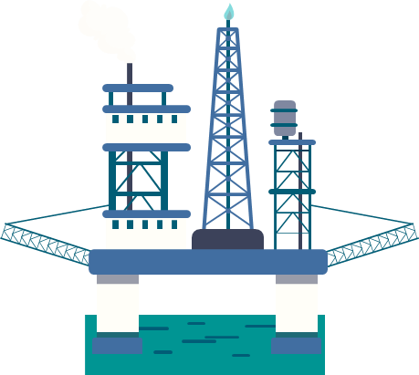
There is more into it..
There are several ways to transport oil after production, including:
Pipelines: Oil can be transported through pipelines, which are the most efficient and cost-effective method for long-distance transportation.
Tankers: Oil can be transported by tanker ships, which are specially designed vessels that can carry large quantities of oil. Tankers can transport oil to ports all over the world.
Rail: Oil can also be transported by rail, using specially designed railcars. This method is often used to transport oil to locations that are not accessible by pipeline.
Trucks: Oil can be transported by truck, typically used for shorter distances, and can be useful for providing oil to remote locations or for emergency supply.
Barge: Oil can be transported by barge, typically used for short-distance transportation on rivers and coastal waters.
The method chosen will depend on the quantity, quality, and location of the oil, as well as the availability of transportation infrastructure and the destination of the oil.

Slide 12
Even more,
There are several methods for storing oil after production, including:
Tank storage: Oil can be stored in large above-ground tanks or underground tanks that are designed to withstand the weight of the oil and prevent leaks.
Underground storage: Oil can be injected into underground geological formations, such as salt caverns, for long-term storage.
Offshore storage: Oil can be stored in offshore platforms or vessels, such as tankers or FPSOs, which are designed to withstand the harsh marine environment.
Ship storage: Oil can be stored in large vessels, such as tankers, which can transport the oil to different locations.
The method chosen will depend on the quantity, quality, and location of the oil, as well as the availability of storage facilities and transportation infrastructure.

Slide 13


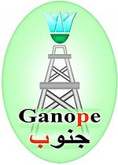
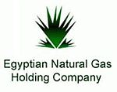
Let's view Egypt’s assets landscape
Since it is already a complex process and requires multiple sub-processes at different assets, with include both governmental and private sectors. Egypt has defined its industry into the following entities:
1- Egyptian petrochemicals holding Co. (Oil – mostly mid stream)
2- Egyptian General Petroleum Co. (Oil – mostly up/midstream)
3- GANOPE holding Co. (Oil – mostly upstream)
4- EGAS holding Co. (Natural Gas)

Slide 14
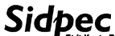

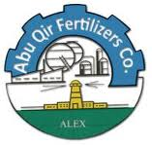


More insides..!
Provide local demand of up to 55% of oils, 80% of condensates, 65% of bitumen.
- Products: Bitumen, Nafta, kerosene, gaseous petroleum
Egyptian Petrochemichal Co. (Chemicals)
Alexandria Specialty Petroleum Products Co. (Wax&grease)
Sidi Kerir Petrochemicals Co. (Polyethylene)
Misr Oil Fertilizers Co. (Ammonia&Urea)
Abu Qir Fertilizers
Egyptian Linear Alkyl Benzene

Slide 15

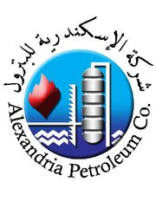

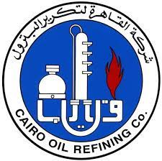
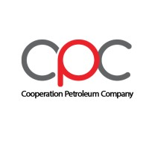
More insides!
[16 fields in Eastern Desert – 3 fields in Western Desert – 3 fields in Sinai area]
General Petroleum Co. (Search & Extract)
Alexandria Petroleum Co. (Oils & byproducts)
Cairo Oil Refining Co. (Fuels & byproducts)
Amreya Petroleum Refining Co. (byproducts)
Misr Petroleum Co. (Oils & fuels)
Cooperation Petroleum Co.
Considered about 25% of Egypt’s refinement capacity (Mostorod and Tanta labs).
Involved in designing and maintaining production units and tools.
Posses about 1550 distribution vehicles, 3 refining centres, 3 distillation labs, 921 outlets, 13 marine vessels, research centre.
Posses a large-scale refinement centre (EL-Max), a distillation centre(Amreya) , 13 storage warehouses, 600 distribution vechiles, 1508 outlets.

Slide 16
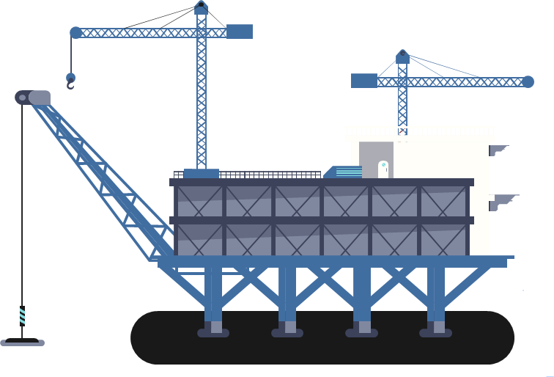
More insides!
- Produce in total about 22,000 barrels/day!!
Was built with 100% Egyptian hands.
Has jet fuel production line!
Assiut Oil Refining Co. (fuels & byproducrs)
Kom-Embu Petroleum Co. (Extraction) [Shared with mid-tera “France”]
Petrogulf Co. (Search & Extraction) [Shared with Bico & chereon)
Tanmeya Petroleum Co. (Solutions and infrastructure) [Shared with Ennpie&Petrojet]
Alameya drilling tools Co. (Solutions and maintenance)
Magawesh Petroleum Co. (Extraction) [Shared with trident energy]
Aash-elmelaha Petroleum Co. (Extraction) [Shared with loc-oil ‘Russia’]
Poses about 23 oil fields, extracting about 400 barrels/day

Slide 17
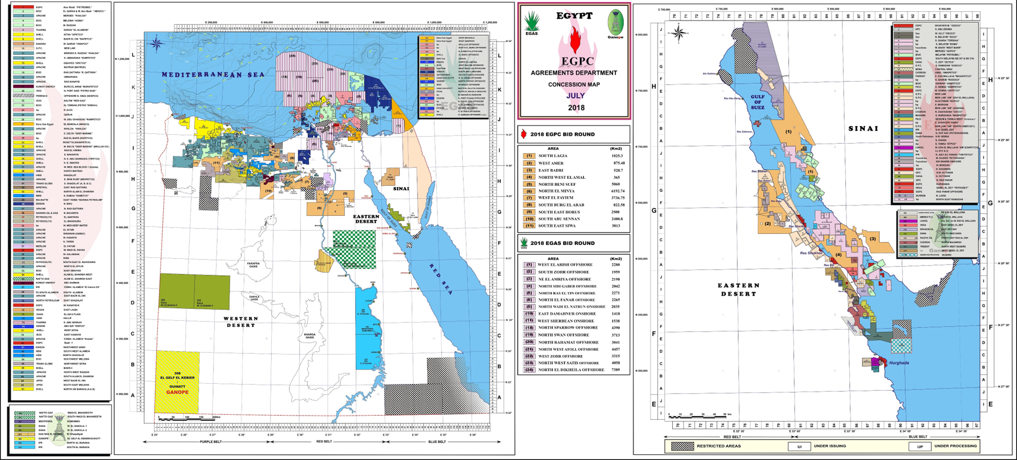
Egypt’s Concession Map

Slide 18
What the hassle?
Many process involving various procedures and constraints within multiple different entitles!
Very little room for errors and high reliance on quality and standards
Divide & Conquer? It is the software developer instinct!
A Software? Lets first clearly identify the dilemma..
A typical refinery, or any liquid-based manufacturing plant has billions of dollars’ worth liquid assets (crude oil , manufactured intermediate and final products) in 150-300+ storage tanks. The inventory of these assets are monitored in real-time and moved within and across refinery boundaries in 100+ movements on daily basis. The management of these assets is crucial not only from safety (spillage, explosion, equipment burn-outs) point of view but also for reconciliation of receipts and dispatches to avoid discrepancies and thereby avoid huge losses of revenue or overpaid for less than ordered delivered products.

Slide 19
But I think its already there…
Actually, there are various software systems already out there that those entities use everyday for automation and communication.
Tank management system: This software is used to monitor and manage the storage tanks used for crude oil, refined products and chemicals. It includes features such as inventory tracking, leak detection, and automatic tank gauging.
Fleet management system: This software is used to manage and track the company's fleet of vehicles, including trucks, tankers, and other equipment. It includes features such as GPS tracking, vehicle maintenance scheduling, and fuel consumption monitoring.
Environmental management system: This software is used to ensure compliance with environmental regulations, including monitoring emissions, tracking waste disposal, and reporting on environmental performance.
Health, Safety, and Environment (HSE) management system: This software is used to ensure compliance with health, safety and environmental regulations and standards. It includes features such as incident reporting, risk assessment, and safety training management.
Supply Chain management software: This software is used to manage and optimize the flow of goods and services within the petroleum industry, including logistics, inventory, and procurement.

Slide 20
We still see some breakpoints
Those multiple systems through different entities operate at similar scheme toward the same target, but there is no real integration and synchronization of these systems (up-mid-down), that would also enforce compliance and centralization. Also, I see you could imagine the quantity of data per system that is completely isolated from the others.
Tracking the whole end-to-end process from a unified platform would provide a high opportunity to reduce error while enhancing the whole process assisted by the collected data.
Some entities in the industry may intentionally or unintentionally alter or monopolize some data without immediate warning or detection.

Slide 21
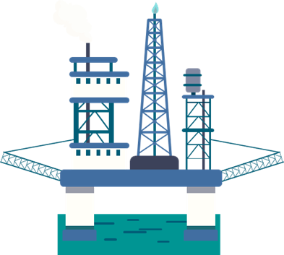
Let's change that! What about
One system serve all and have all data to process and track at once??
To put this clearly..
IRIS [integrated Refinery Information System]
It is an integrated system of applications that supports a structured way of handling crude supports the industry to leverage IT to run processes more effectively and efficiently. IRIS movements, managing plant operation, data validation, production accounting, real-time data IRIS platform.
That seems promising…

Slide 22
How far this could make it?
Reducing errors would translate to a reduce in potential losses. We expect about 20% increase in ROI (in ideal operation environments).
Data collected throughout to used in data models that would provide user with potential losses/wins, Detect any odd patterns that could include incidents that need actions or investigations, predict any future trends or instabilities

Slide 23
IRIS is a boring name…
What about ?

Slide 24
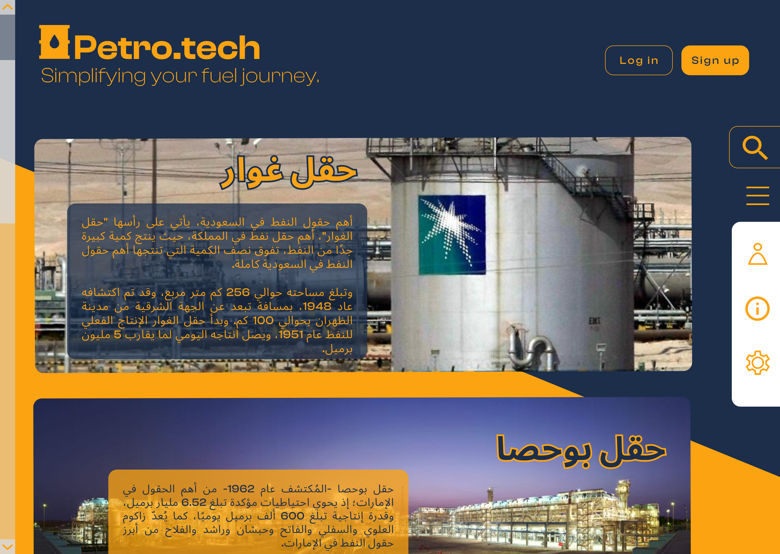
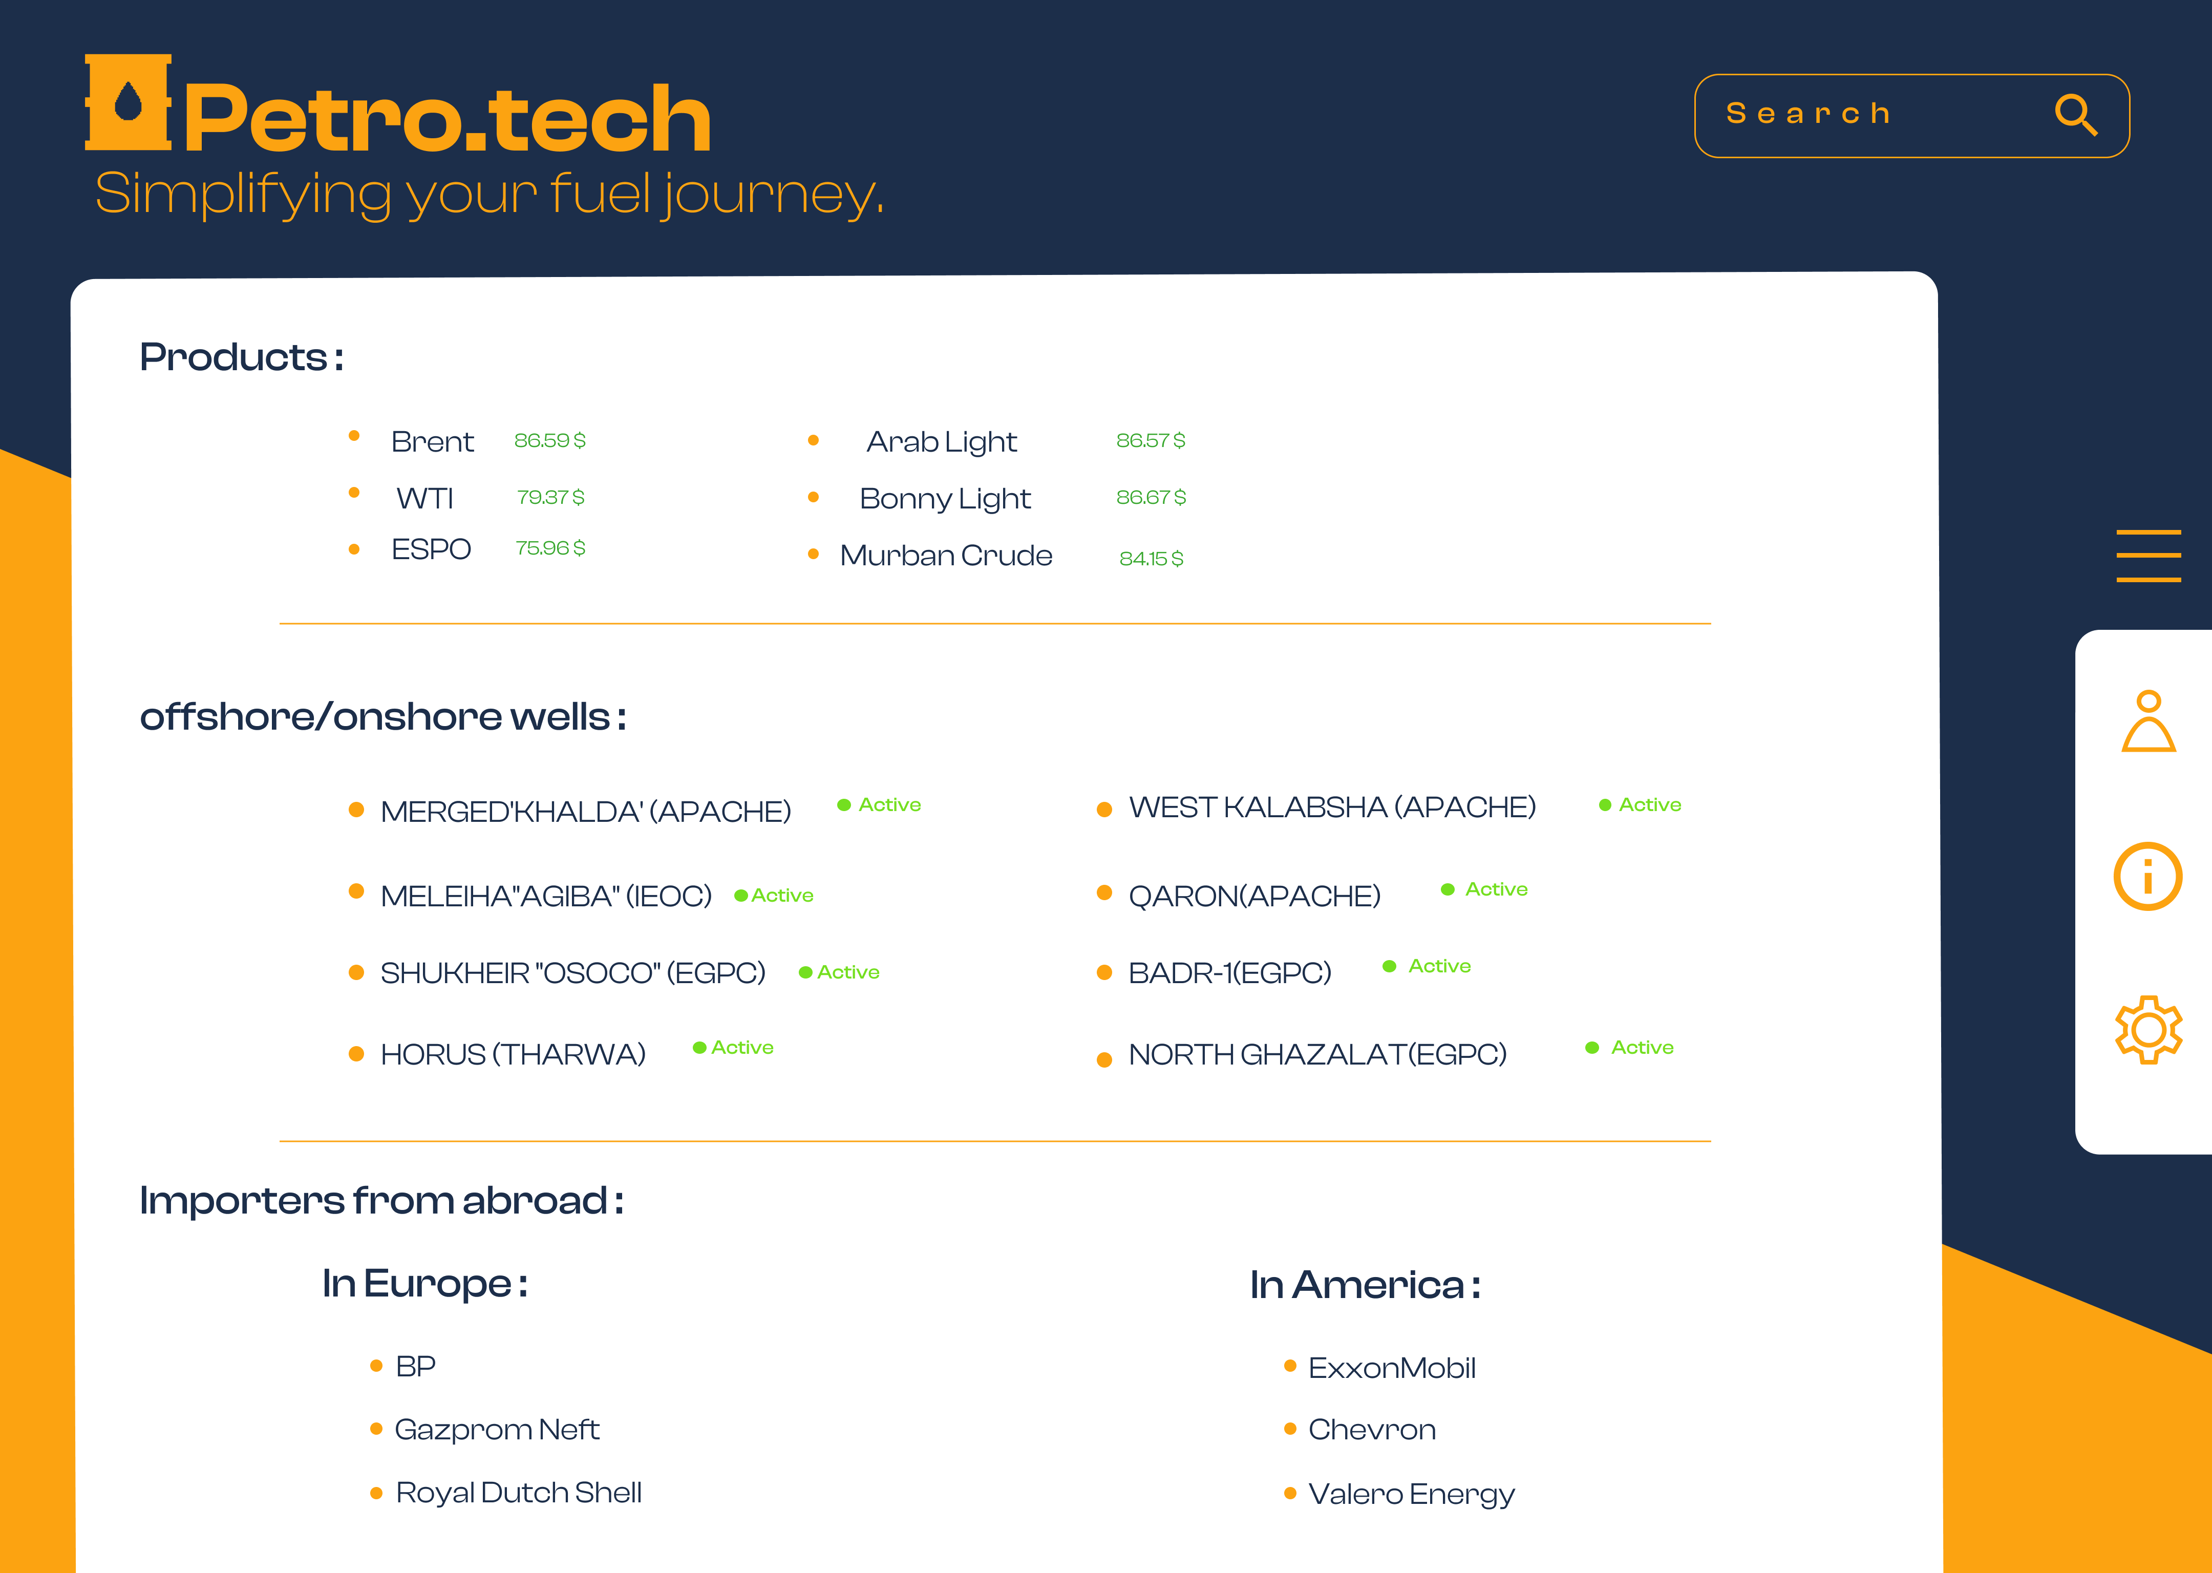
Prototype ( Demo )
( Home page )
( Dashboard )

Slide 25
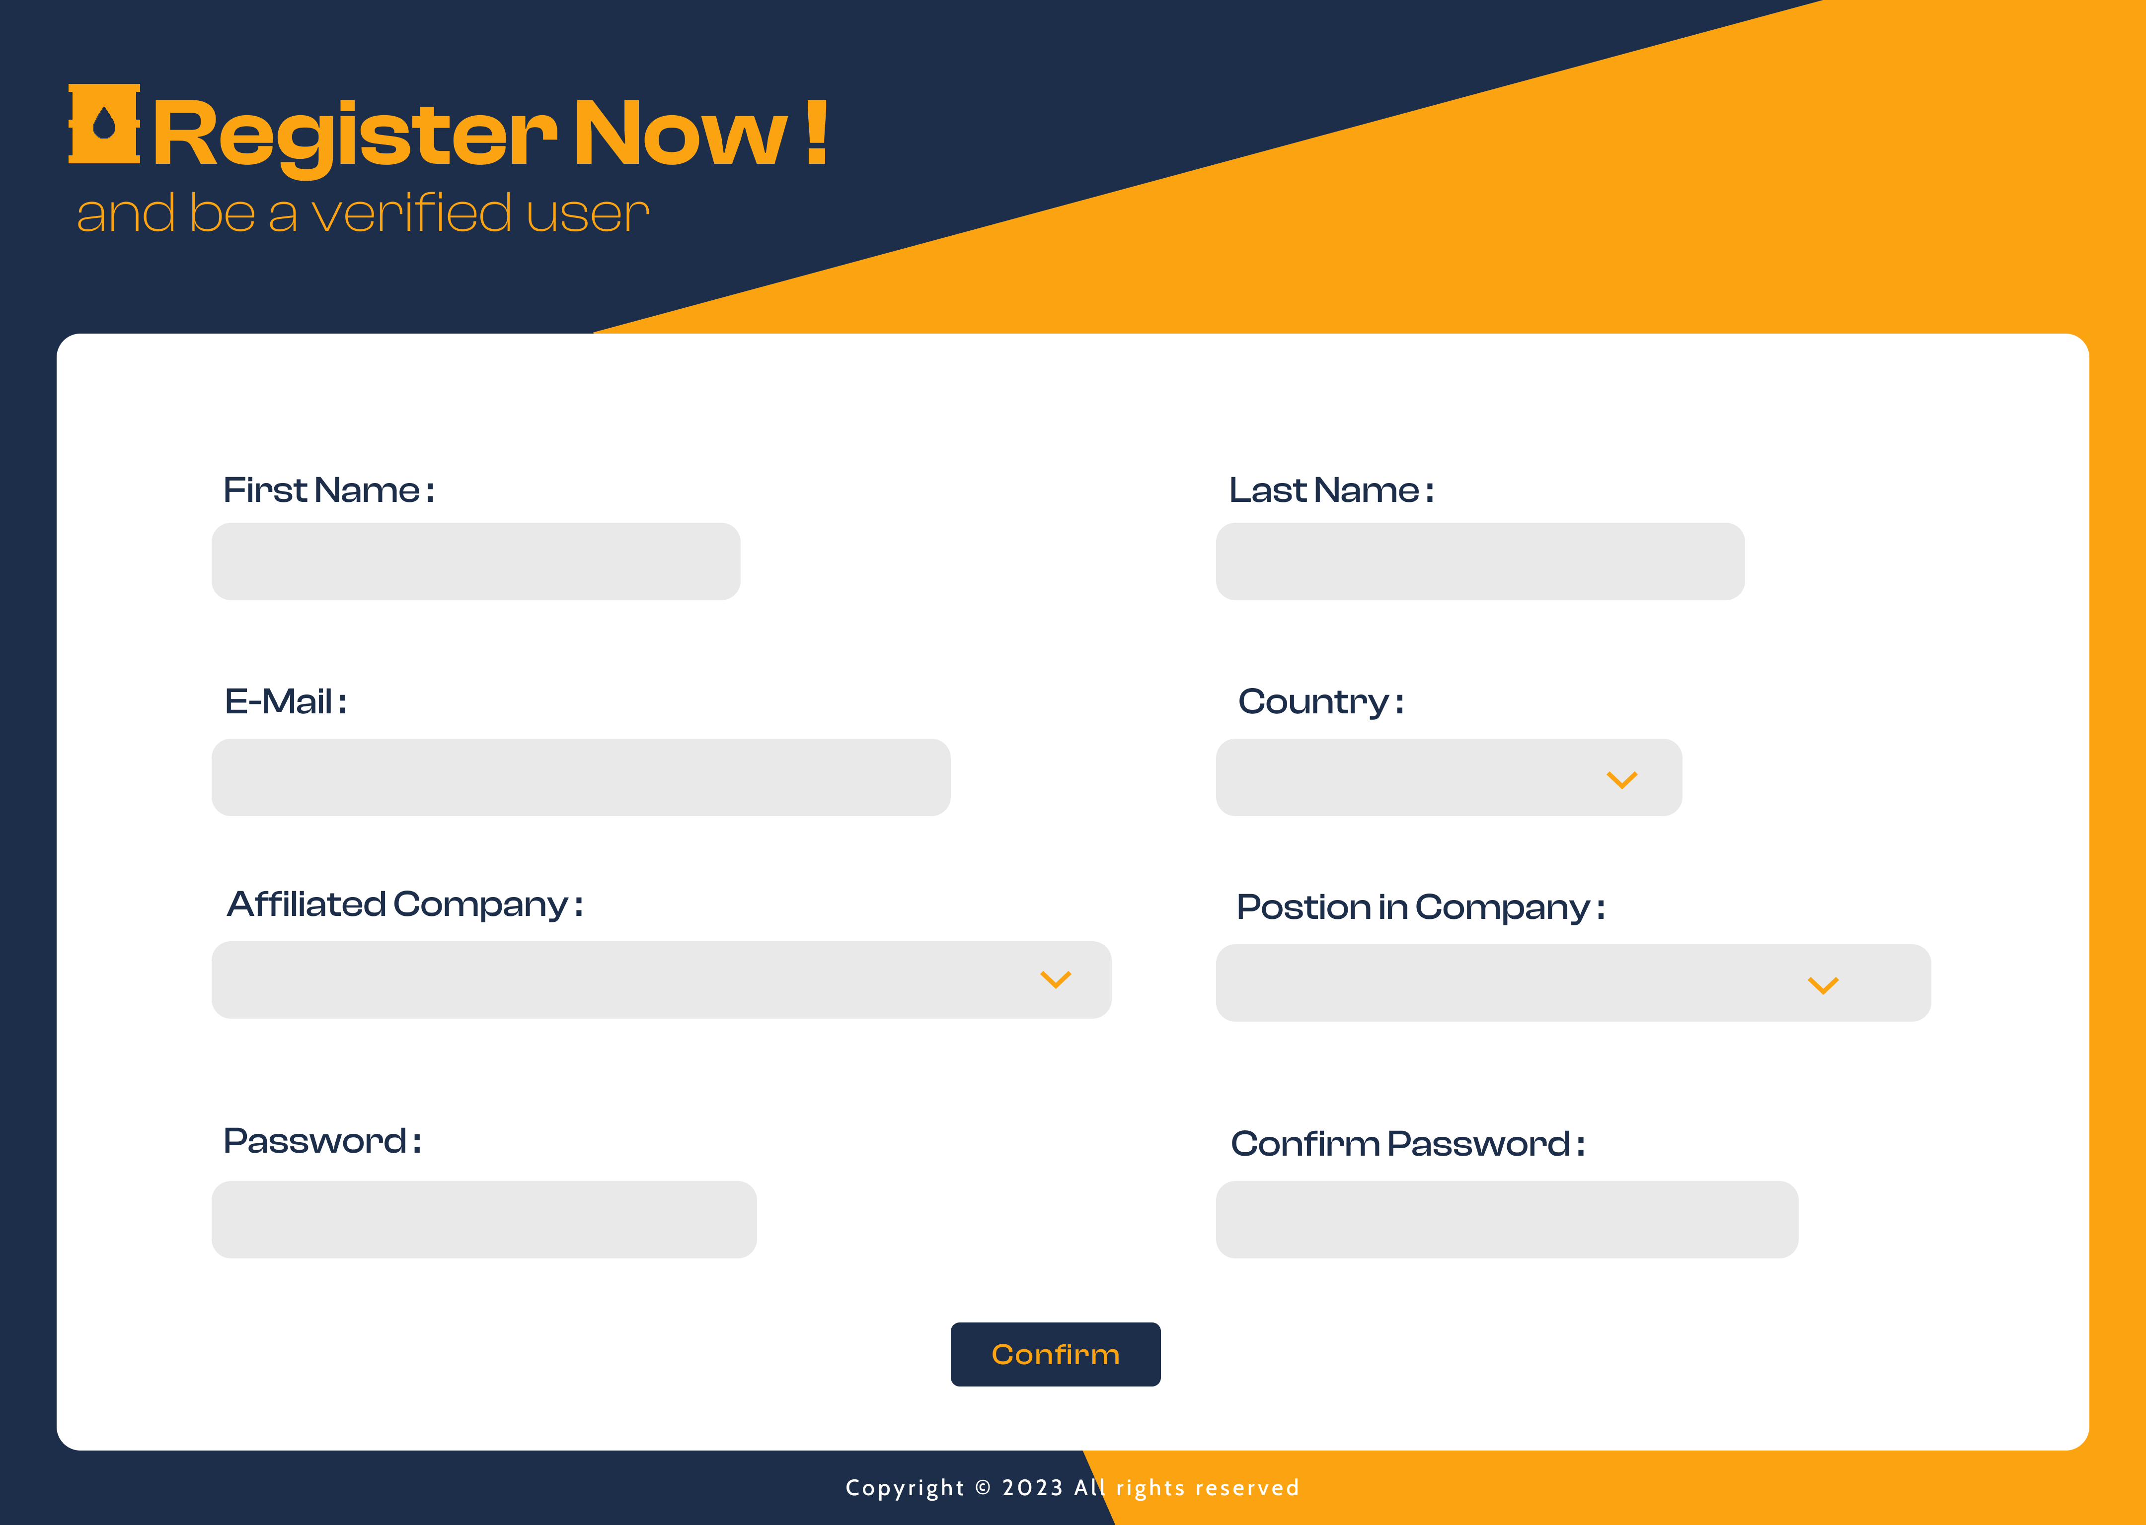

Prototype ( Demo )
( Register)
( Login )

Slide 26
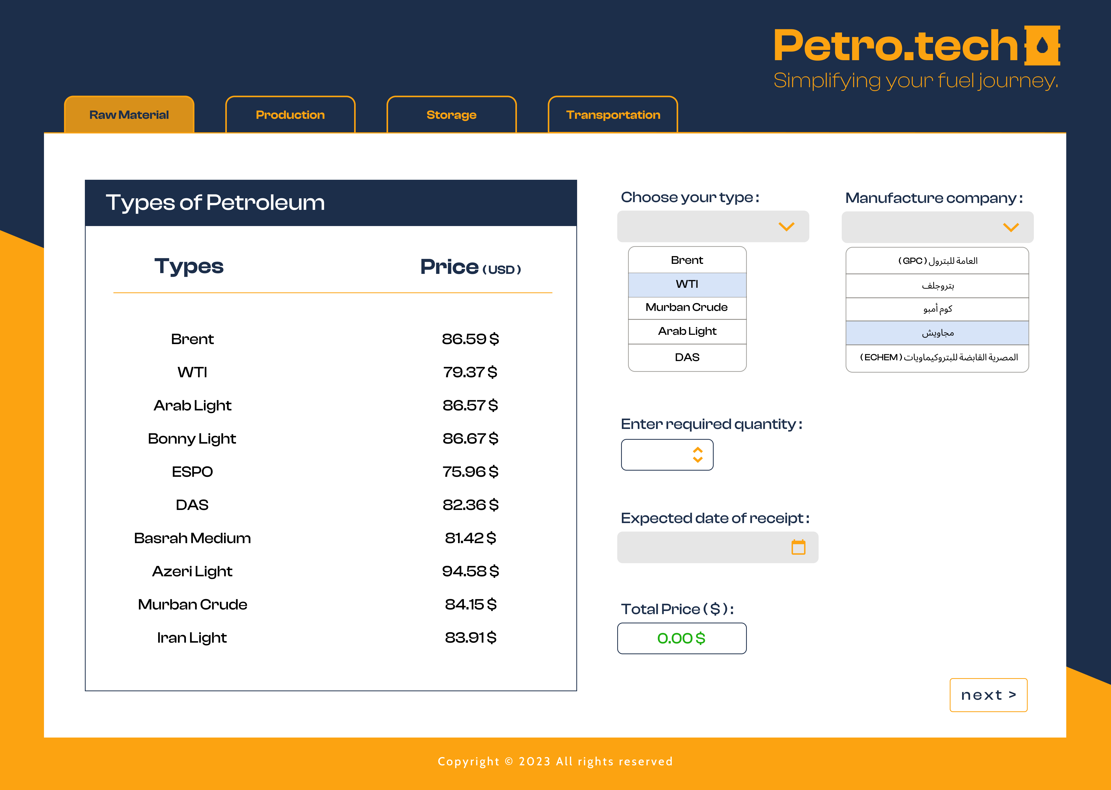
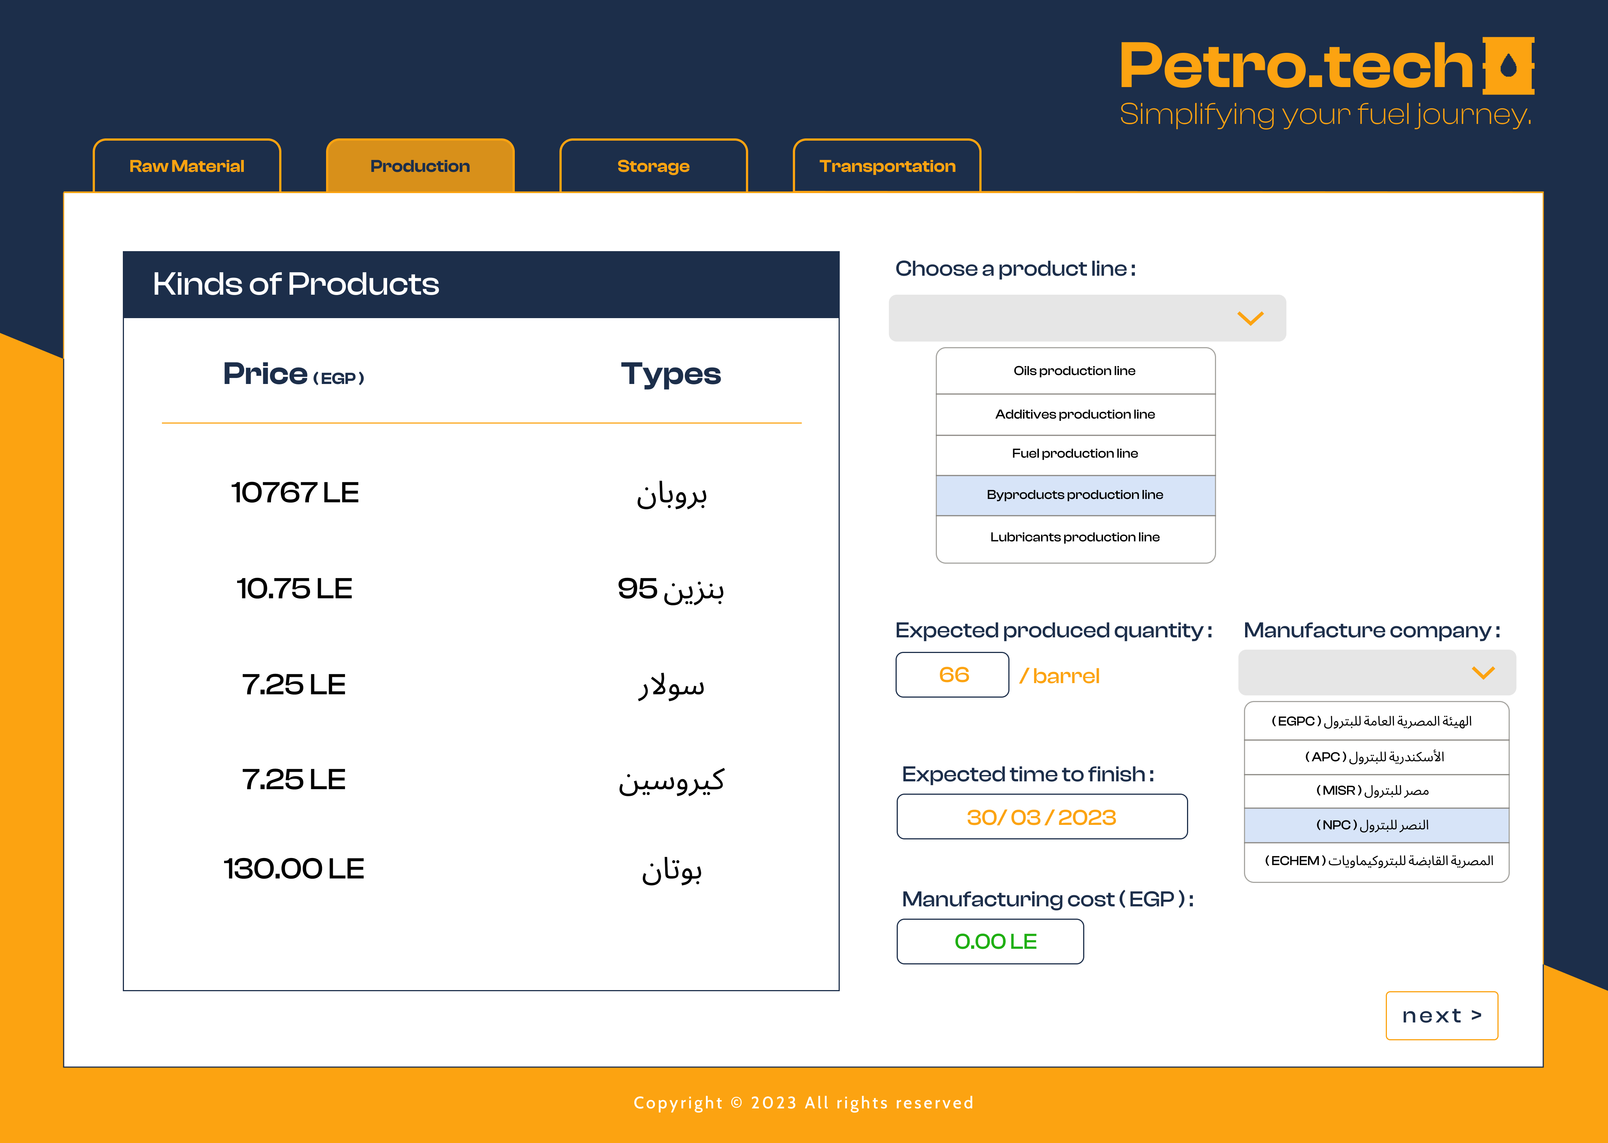
Prototype ( Demo )
( Raw material)
( Production )

Slide 27
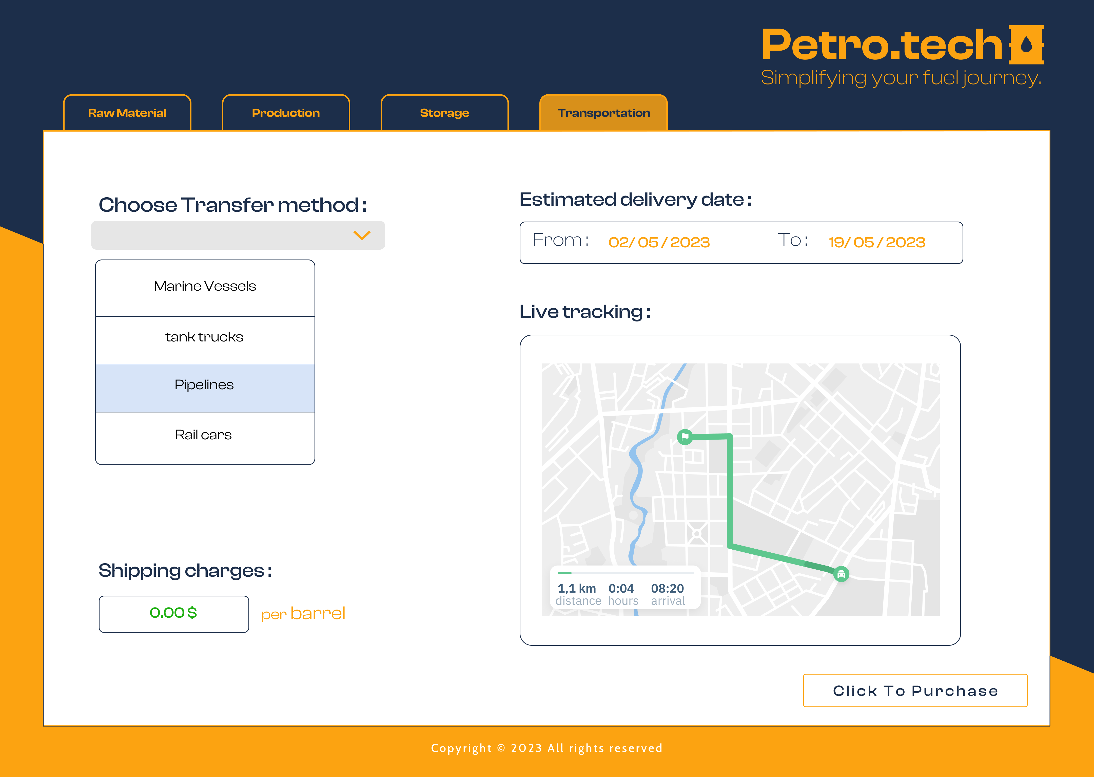
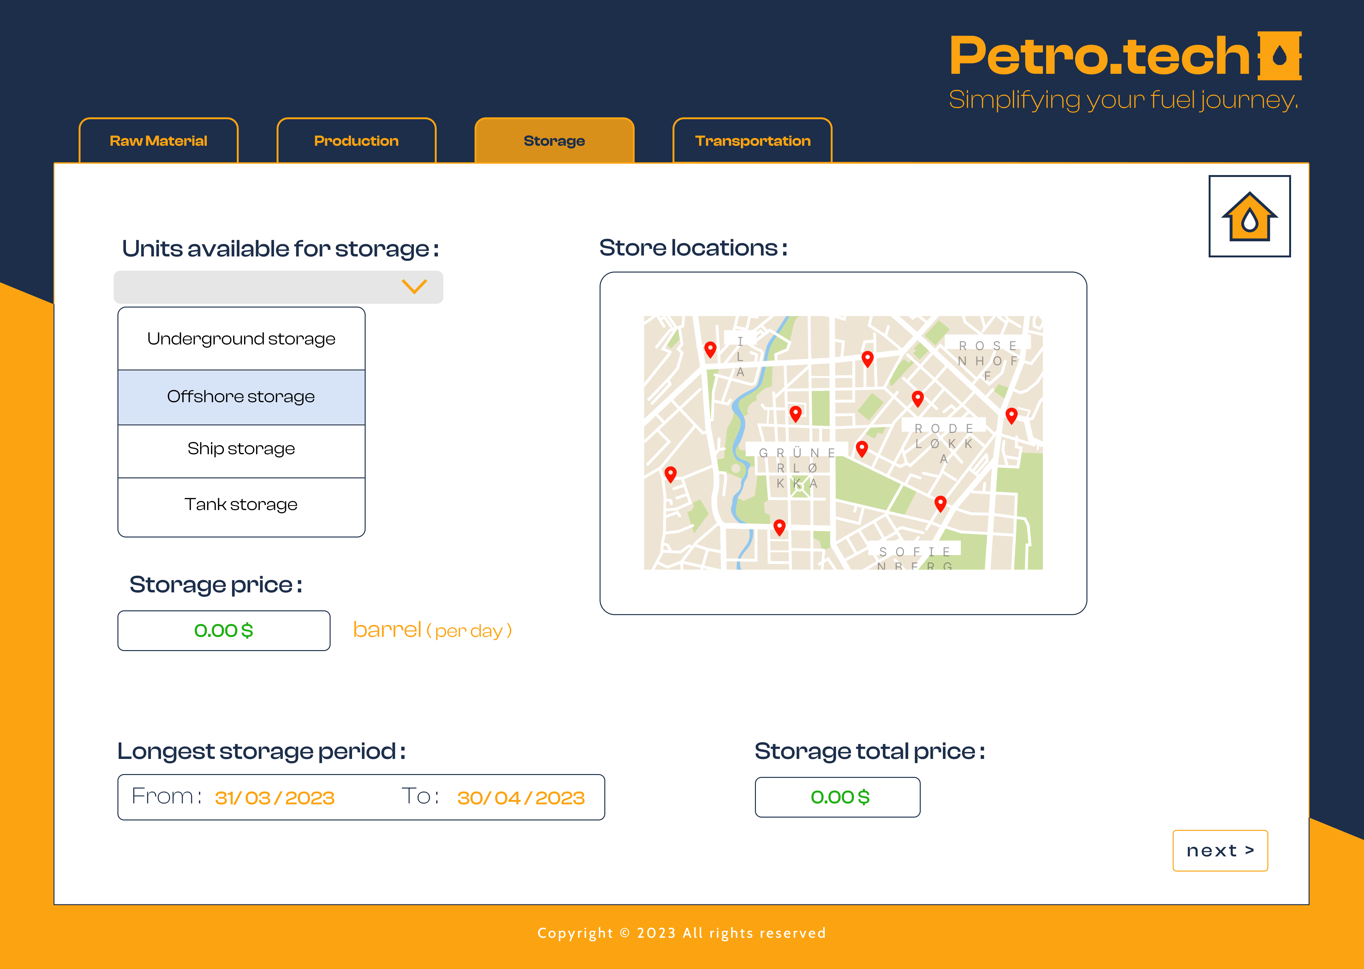
Prototype ( Demo )
( Transportation )
( Storage )

Slide 28
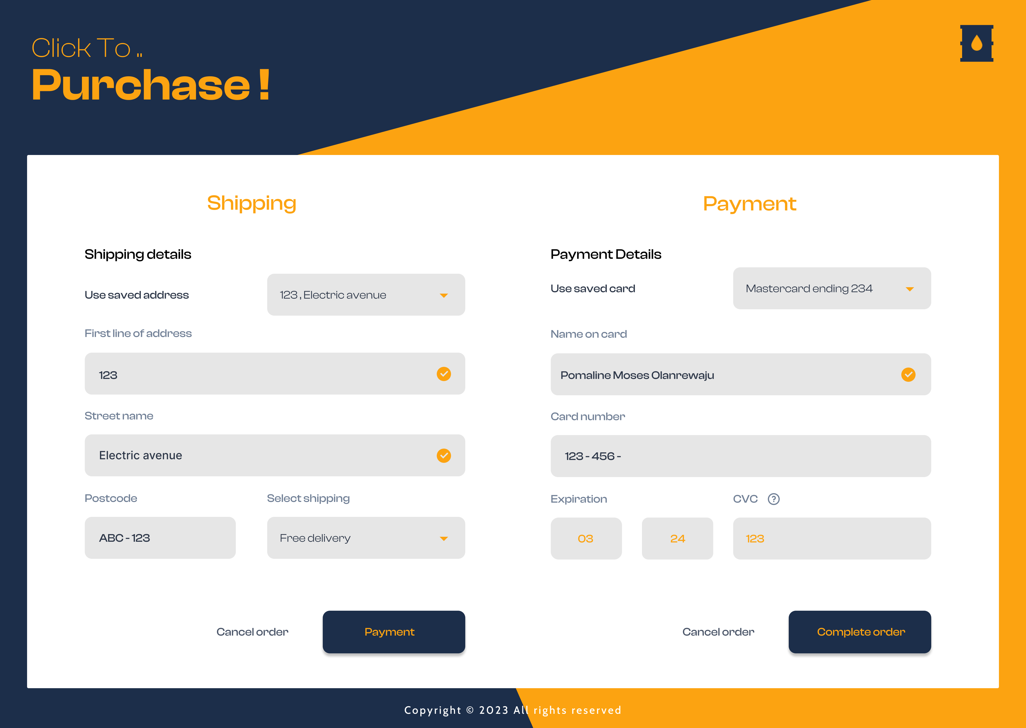
Prototype ( Demo )
( Purchase )

Slide 29
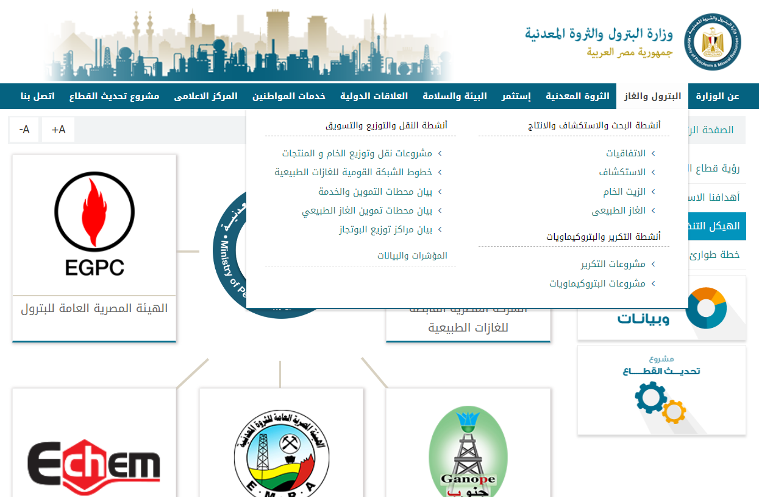
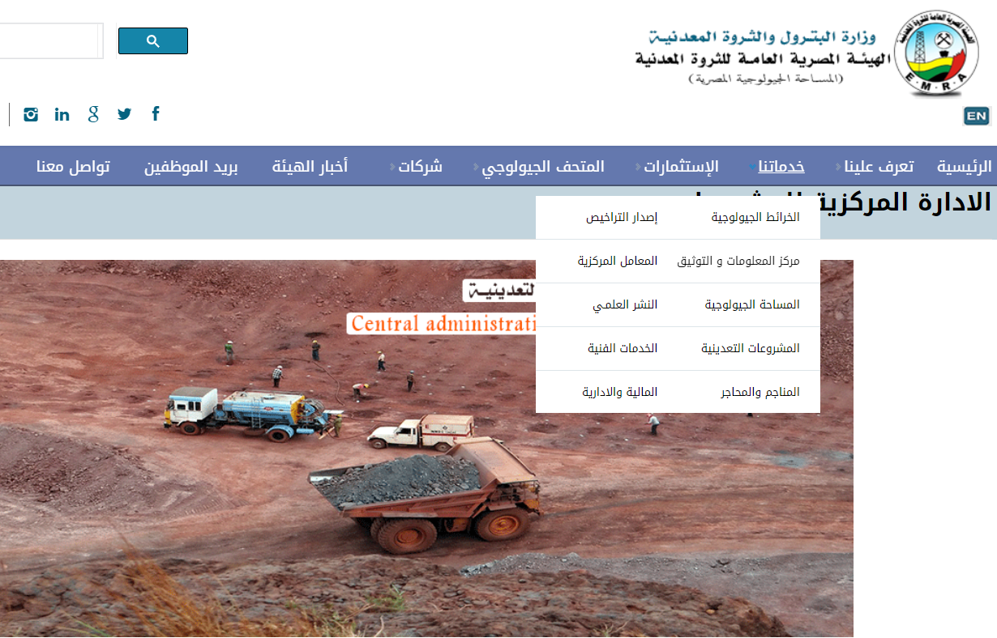
Similar Systems

Slide 30
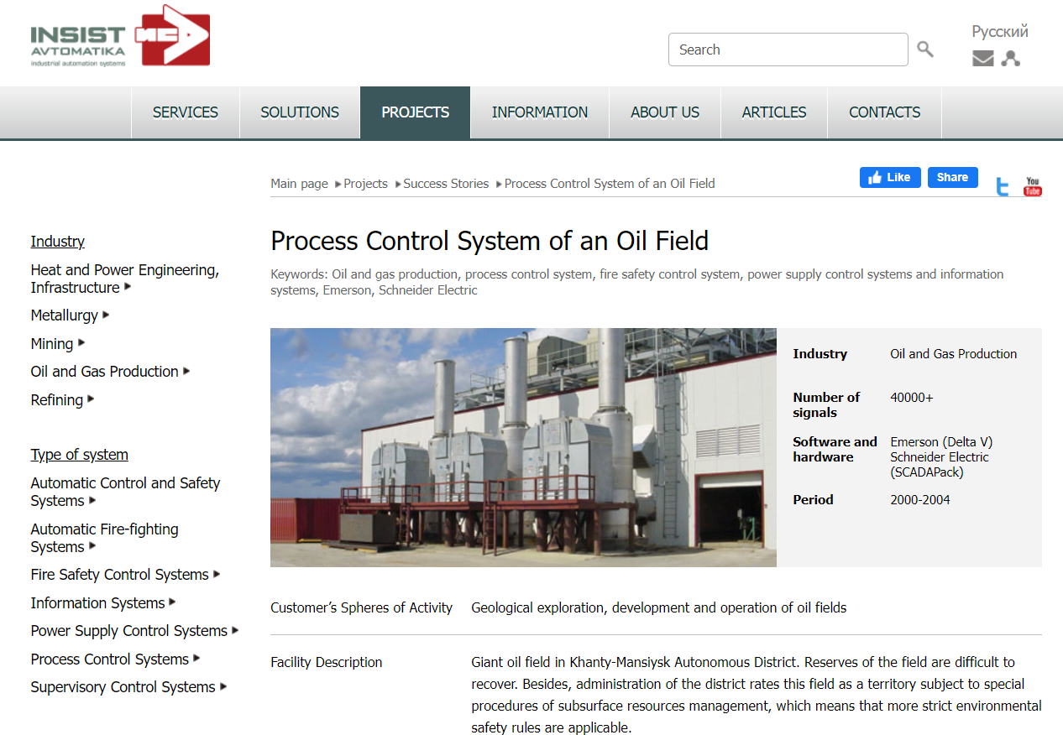
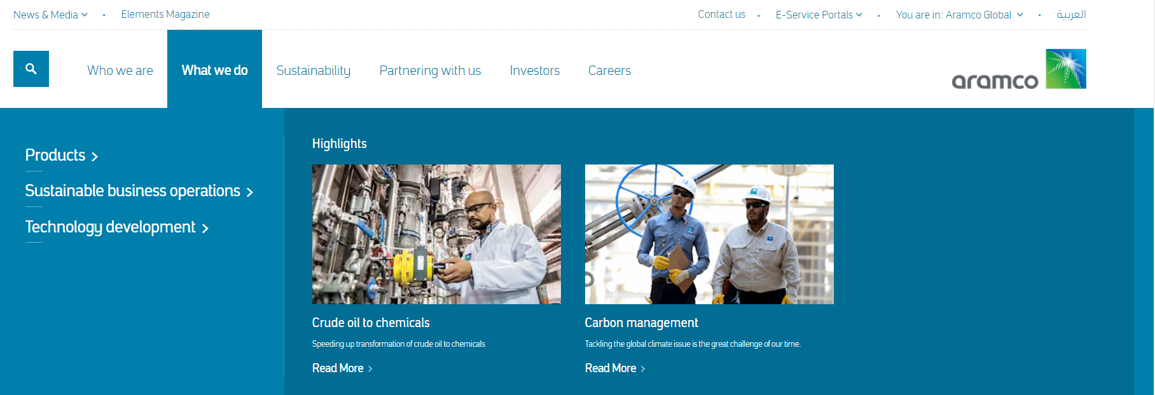
Similar systems

Slide 31
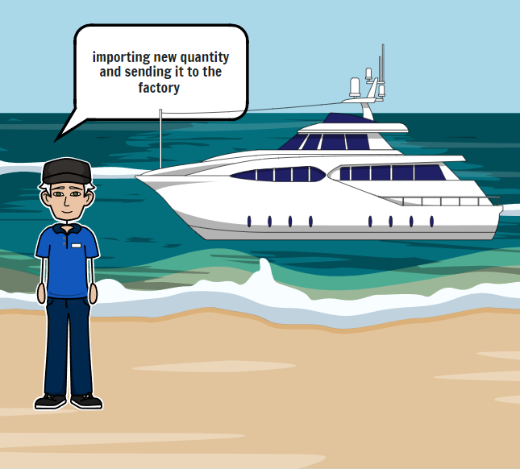
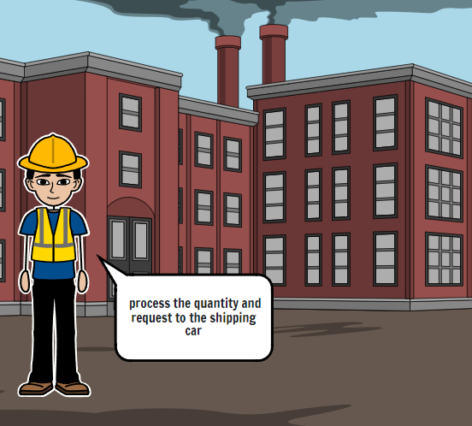
Story Board

Slide 32
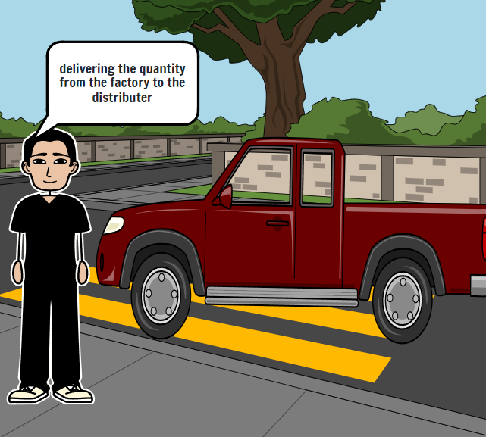
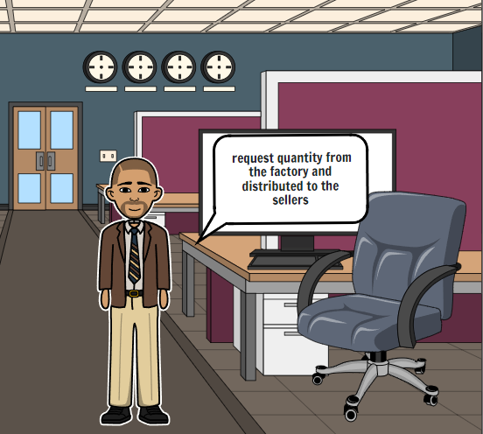
Story Board

Slide 33
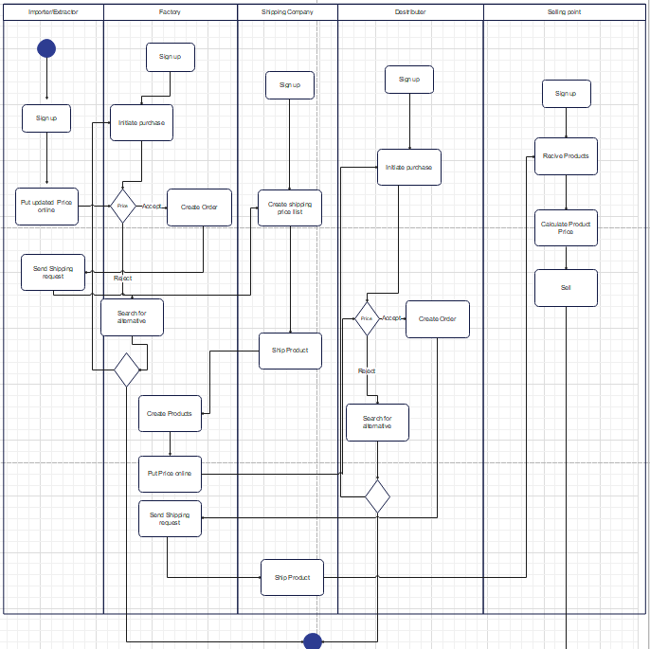

Activity Diagram

Slide 34
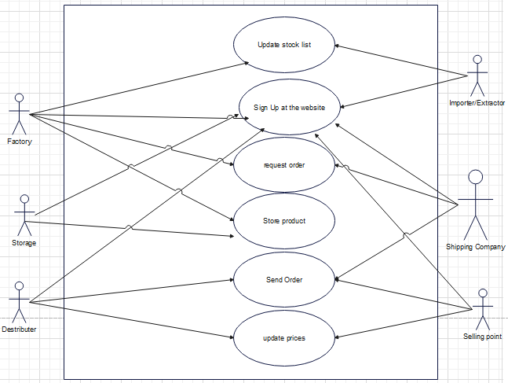
Use case Diagram

Slide 35
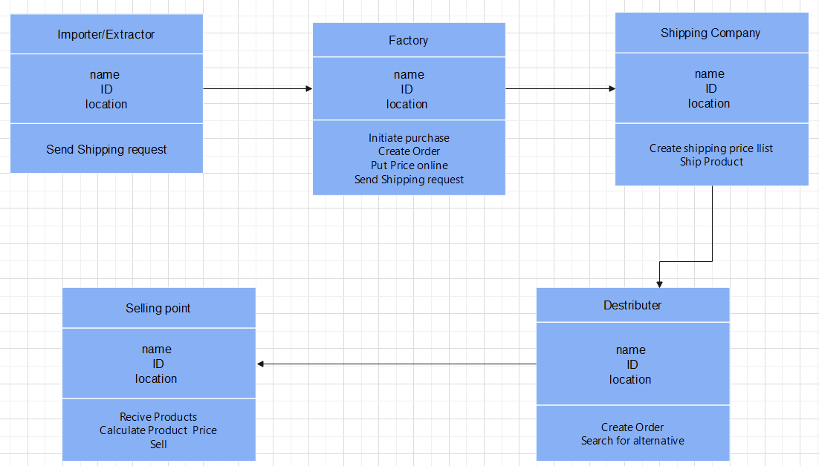
Class Diagram

Slide 36


State Diagram

Slide 37

Sequence Diagram

Slide 38

Technology for implementation
Front-end : React-based (Framework)
React makes it simple to create interactive user interfaces. It allows building stand-alone UI components and entire user interfaces, including all the visual elements and the logic that underlies and governs these elements. In the first place, React is designed for building robust component-centric applications.
Reacts serves as a vibrant ecosystem of tools and approaches, which conditions its having so many different use cases – web app development, mobile app development(React Native), static site building, desktop apps development, and even VR app development.

Slide 39

Technology for implementation
Back-end: PHP (Laravel framework)
Laravel Development Means Faster Time-To-Market
Security : Better Authentication and Authorization
MVC architecture provides better documentation, improved performance, and multiple built-in functionalities
Unit testing: Laravel let you test each component or module of your app to ensure that the integrated application performs well when all the modules add up.
High scalability, Easy third-party integrations.

Slide 40

Workflow for implementation
Agile/scrum workflow is a perfect match since our development would need to develop and test more specifically than most other software
iterative approach is suitable due to the number of endpoints involved within the software. Continuous prototyping would ensure compliance with endpoints standards
Scrum master who will have identified key Scrum metrics to measure individual components of the workflow as well as the process as a whole.
For example:
Sprint goal success
Team velocity
Time to market
ROI
The Scrum master will refer to these to continually refine and improve the process.

Slide 41
Technology for implementation
Web tokens: T-OTP
This type of OTP is time-based, in that it provides a window of time within which the OTP code will be valid. In general, timesteps are 30-60 seconds in length. If the user does not enter the OTP code within the specified timestep, they must request a new one.
In other words, Time based OTP will have OTP generator running on client and server that are time synchronized. For instance, if you try to access AWS (with Two factor authentication), then once you login with your password, you usually will have few seconds to enter the OTP. If you wait too long, you will have to login again.
OTP generation algorithms typically make use of pseudo randomness or randomness to generate a shared key or seed, and cryptographic hash functions, which can be used to derive a value but are hard to reverse and therefore difficult for an attacker to obtain the data that was used for the hash. This is necessary because otherwise, it would be easy to predict future OTPs by observing previous ones.
When correctly implemented, OTPs are no longer useful to an attacker within a short time of their initial use. This differs from passwords, which may remain useful to attackers years after the fact.

Slide 42


Technology for implementation
Data tokens: API
OilpriceAPI is a modern JSON API that returns well formatted, live and historical oil price data.

Slide 43



Technology for implementation
Data tokens: API
MarineTraffic API allows you to integrate AIS data into your application or website. You can harness all this data, along with port calls, ship particular locations and routes

Slide 44



Software infrastructure (deployment)
Serverless computing enables developers to build applications faster by eliminating the need for them to manage infrastructure. With serverless applications, the cloud service provider automatically provisions, scales, and manages the infrastructure required to run the code. This technology also eliminate infrastructure management tasks like capacity provisioning and patching, so you can focus on writing code that serves your customers. Serverless applications start with AWS Lambda, an event-driven compute service natively integrated with over 200 AWS services and software as a service (SaaS) applications.
In understanding the definition of serverless computing, it’s important to note that servers are still running the code. The serverless name comes from the fact that the tasks associated with infrastructure provisioning and management are invisible to the developer. This approach enables developers to increase their focus on the business logic and deliver more value to the core of the business. Serverless computing helps teams increase their productivity and bring products to market faster, and it allows organizations to better optimize resources and stay focused on innovation.

Slide 45

Software infrastructure (deployment)
Amazon Simple Storage Service (Amazon S3) is an object storage service offering industry-leading scalability, data availability, security, and performance. Customers of all sizes and industries can store and protect any amount of data for virtually any use case, such as data lakes, cloud-native applications, and mobile apps. With cost-effective storage classes and easy-to-use management features, you can optimize costs, organize data, and configure fine-tuned access controls to meet specific business, organizational, and compliance requirements.

Slide 46

Software infrastructure (deployment)
Amazon DynamoDB is a fully managed, serverless, key-value NoSQL database designed to run high-performance applications at any scale. DynamoDB offers built-in security, continuous backups, automated multi-Region replication, in-memory caching, and data import and export tools.

Slide 47


Software infrastructure (deployment)
Serverless computing enables developers to build applications faster by eliminating the need for them to manage infrastructure. With serverless applications, the cloud service provider automatically provisions, scales, and manages the infrastructure required to run the code. This technology also eliminate infrastructure management tasks like capacity provisioning and patching, so you can focus on writing code that serves your customers. Serverless applications start with AWS Lambda, an event-driven compute service natively integrated with over 200 AWS services and software as a service (SaaS) applications.
In understanding the definition of serverless computing, it’s important to note that servers are still running the code. The serverless name comes from the fact that the tasks associated with infrastructure provisioning and management are invisible to the developer. This approach enables developers to increase their focus on the business logic and deliver more value to the core of the business. Serverless computing helps teams increase their productivity and bring products to market faster, and it allows organizations to better optimize resources and stay focused on innovation.

Slide 48


Realtime data and notifications
WebSockets with Pusher
Pusher Channels is a hosted WebSockets solution for building powerful realtime interactive apps. it solves complex realtime infrastructure so you don’t have to.
Bi-directional data exchange/transfer
By transmitting data in both directions simultaneously through a single connection, you can greatly reduce unnecessary network traffic and delay
Traverse firewalls and proxies with ease
Power through proxies and firewalls, supporting simultaneous two-way upstream and downstream communication
Backwards compatible with HTTP connections
Compatibility with earlier versions of HTTP connection meaning you can switch between HTTP and WebSocket connections as required
Publish/Subscribe event pattern
Channels allows you to send messages to and from a server and receive event-driven responses without continuously polling the server, resulting in a highly efficient data transfer model

Slide 49
Future implementation plans
Develop a test-extensive plan to ensure bug avoidance and compliance with international measures
An inspection subsystem would act as a night watcher through multiple modules of our software
Enhance User experience having in consideration users’ UX at previous systems (accessibility)
Develop an AI based data model that would monitor or suggest specific data based on probabilities and pattern recognitions
Detect and interfere with faulty processes
safety (spillage, explosion, equipment burn-outs)
avoid discrepancies and monopolizing and thereby avoid huge losses

Slide 50
THANK YOU !

